Slide 1
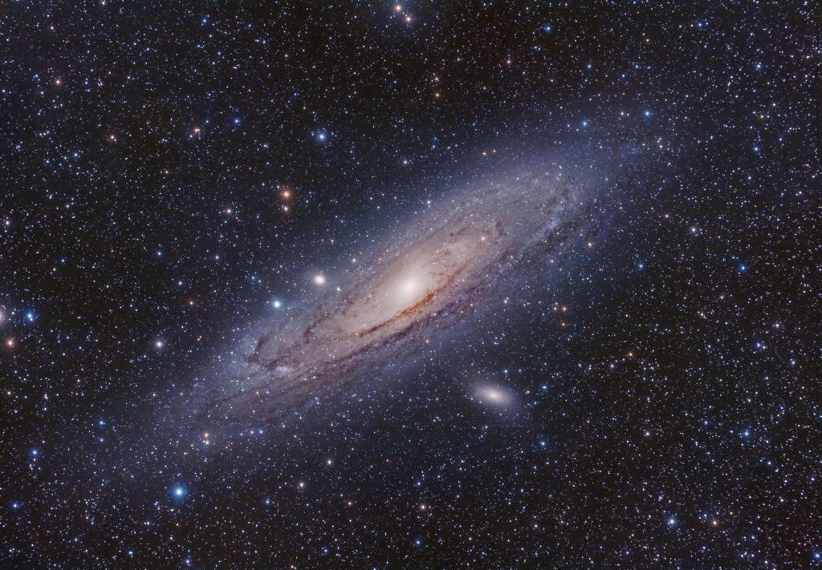



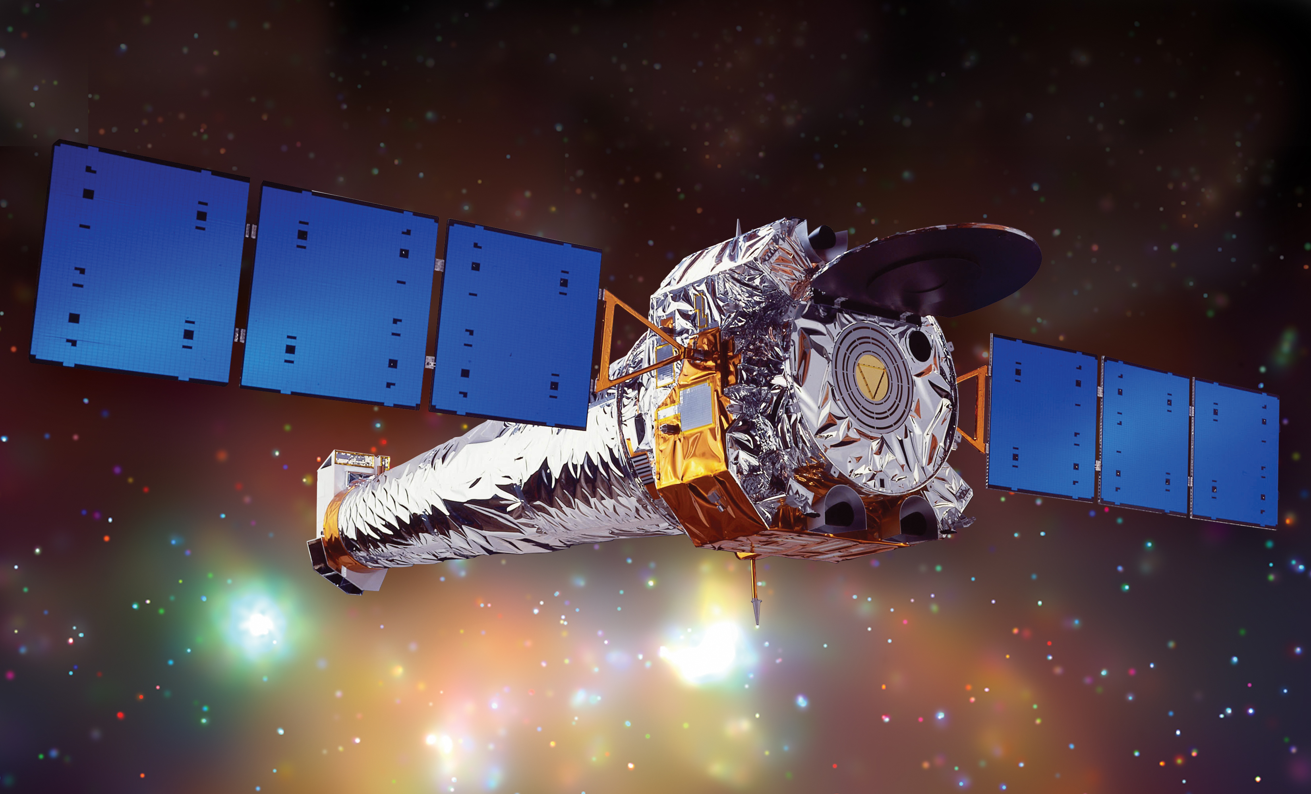
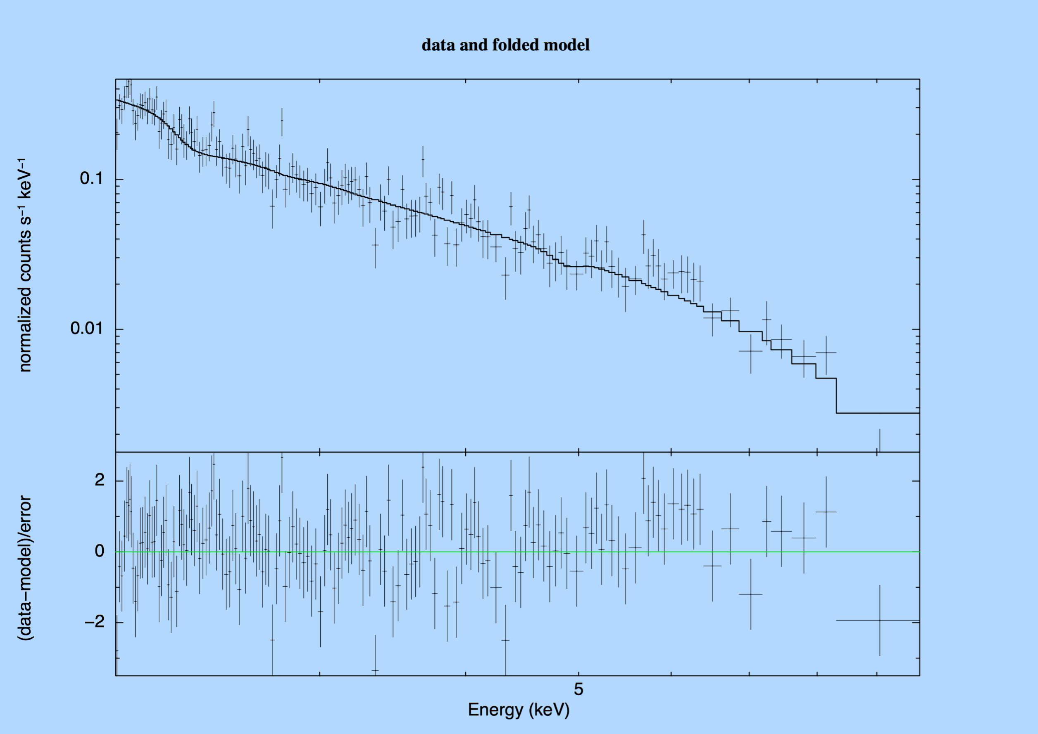
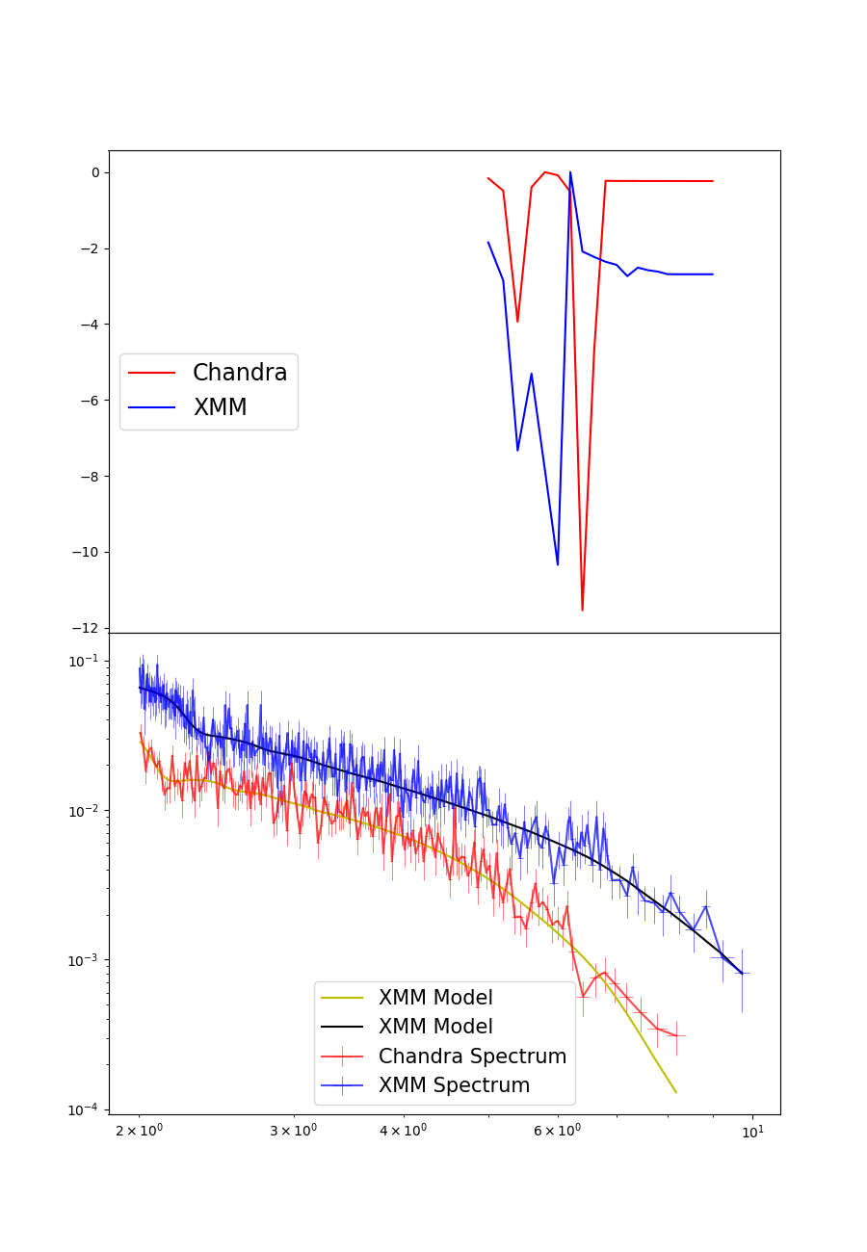





A systematic search for absorption features in the X-ray spectra of ultraluminous X-ray sources
Andrew Sosanya
NASA NuStar, Caltech
M. Brightman, F.A Harrison, H.P Earnshaw, K. Madsen, D.J Walton, M. Heida
Neutron Star-Powered X-Ray Sources
Ultraluminous X-ray sources (ULXs) are variable, non-nuclear bright X-ray sources in nearby galaxies not associated with the central supermassive black hole. These ULXs are brighter than black hole systems in our galaxy—they have super-Eddington luminosities greater than stellar mass black holes. These ULXs break the Eddington theory because there are extreme accretion rates onto a compact stellar remnant, or an intermediate mass black hole. It was previously thought that only black hole accretion could power ULXs, but the discovery of pulsations has shown that neutron stars may also power ULXs. Using the data from the XMM-Newton and Chandra X-ray observatories, we conducted a systematic search to find cyclotron resonance scattering features in the X-ray spectra of ULXs to identify neutron-star powered ULXs. The results may findings provide further insight into the analysis techniques for future neutron star-powered ULXs and estimation of their magnetic field strengths.
XMM-Newton (left),
and Chandra Observatory
(right)
Analysis & Results
The systematic search found three strong candidates for analysis: Holmberg II X-1, IC 342, and M32.
Holmberg II X-1
Unidentified feature found in Holmberg II at $E\sim 3.35$ keV, yet $χ^{2}=6$
Eddington Luminosity
The Eddington Luminosity is the maximum luminosity a star attains when radiation pressure from the star and gravitation pressure are balanced.
$${ G}_{NS}$$
$$F_{rad}$$
$\frac{dP}{dr}=\frac{kp}{c}F_{rad}$ = $\frac{GMp}{r^{2}}$, where $F=\frac{L}{4πr^{2}}$
$${ L}_{ed}=\frac{4πGc}{k}M$$
IC-342
What are CRSFs?
Ithere was no detection of absorption features in IC-342.
Cyclotron resonance scattering features (CRSFs) are caused by the transitions of charged particles between Landau levels produced by a magnetic field.
Cyclotron lines imply the presence of a neutron star and gives a direct measurement of its magnetic field strength.
M32
The ULXs observed in M32 are proximate to each other, and therefore needed Chandra data for spatial resolution
Methods
Absorptions lines found in two different observations
$E\sim 6$ keV detected at $3σ level$in XMM observation
$E\sim 6.5$keV detected at $2σ$ level in Chandra observation
Systematic Search
Cross-referenced the Serendipitous XMM-Survey to find ULXs with at least 10,000 intensity counts.
Spectral Analysis
Reduced XMM and Chandra data and found favorable spectral extraction parameters using Chi Squared test.
Used X-ray spectral fitting software XSPEC to analyze EPIC-pn and EPIC-MOS detector data and fitted the spectra with a coupled cutoff power law for the continuum and gaussian absorption model (zgauss) for the absorption line.
Ran simulations to assess false alarm rate from statistical fluctuations.
Conclusion & Future Work
Different energies may be due to change in orientation of magnetic field between observations, possibility of an Iron K-edge, or a detector deficiency. High confidence statistic implies fluctuations are unlikely.
Acknowledgements
Caltech WAVE Fellows Program
SoCal Edison
Acknowledgements
M. Brightman et al. 2018
H.P Earnshaw. 2018
Bachetti et al. 2014
D.J Walton et al. 2017
H.P Earnshaw. 2018
Bachetti et al. 2014

